Slide 1
Security Engineering CSE 3SE/CSE 5SE Instructor: Sambuddho Chakravarty
(Semester: Winter 2015)
Week 2: Jan 12 – Jan 16
Lecture 4 and 5

Slide 2
Review of Lecture 2
Classical computer security models – Bell La Padula, Biba
Are old models still valid and usable ?
Models which are more relevant to comtemporary software systems – Saltzer and Schroeder Model: KISS principle, Principle of Least Privileges, Complete Mediation, Least Common Mechanisms, Open Design, Usability etc.

Slide 3
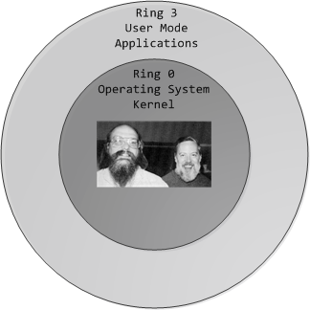
Role of Underlying Systems and Platforms
What policies/filters/mechanisms do underlying system platforms enforce or aid for implementing various forms of access controls?
Memory protection modes – paged virtual memory and segmentation
CPU privilege levels
x86’s 4 privilege level – most modern OSes operate only at 2 levels 0 (most privileged) and 3 (least privileged).
Privileged operations: I/O,
manipulate timer and H/W devices,
MMU operations etc.
Unprivileged operations: Ordinary operations like
R/M operations, arithmetic/floating point ops. etc.
Advantage:
Privilege separation
OS enforced DAC/MAC/RBAC.
OS enforced confidentiality – e.g. Encrypted FS, anonymized
system logs etc.
Platform based security: e.g. Java/Python – strict type and
bounds checking, mediated I/O etc.

Slide 4
Basic *nix Access Controls
Every entity in a *nix system is a file – file, directory, I/O device interfaces, pipes, sockets etc. – each of these have access controls
Used to implement DAC.
Representation:
10 bits – 9 for {u,g,o} x {r,w,x} + 1 directory or file (or character device, block device, named pipe, links (symbolic or hard links))
-rw-rw-rw- alice alice 1.5M 2015-01-01 00:01 img1.jpeg
drwxr-xr-x alice sys 4.0K 2014-01-01 00:01 mydirectory
3 more bits – setuid, setgid, sticky

Slide 5
The /etc/passwd, /etc/shadows and /etc/groups Files
/etc/passwd file format:
alice:x:561:561:Alice Wonderlady:/home/alice:/bin/bash
Username
Password encrypted and stored in /etc/shadow file
UserID
GroupID
Real name associated the username
Home directory
Shell program associated with the user
How can you create a second “‘root’” ?

Slide 6
The /etc/passwd, /etc/shadows and /etc/groups Files
/etc/shadow files
alice:Ep6mckr0LChF:100063:0:7:7:1992873
Username
Encrypted password of the user. Users with passwd as ‘!’ or ‘*’ (meaning ?). Other possible values are blanks (meaning ?).
Date of last password change (expressed in the no. of days since Jan 1, 1970).
Min. password age = min. no. of days the users has to wait to change the password again. Could be 0 (no min.)
Max password age = The max. no. of days after which the user will have to change her password.
Password warning period = The number of days before a password is going to during which the user should be warned.
Password inactivity period = The number of days after a password has expired during which the password should still be accepted.
Account expiration date = Date of expiration of the account, expressed in no. of days since Jan 1, 1970
/etc/groups:
Shows group associations.
alice:x:561:bob, mallory, george

Slide 7
File Permission Bits – Mode and Mask
Octal representation
0644 [(u:110 , rw-) , (g:100,r--) , (o:100,r--)]
Files are by default created with a certain ‘mode’. The ‘mode’ is bitwise-ANDed to the inverted ‘umask’ bits.
Default mode: 0666
Default mask: 022
Default permissions: 0644
Changing the mask value: umask
Changing system wide mask ?

Slide 8
The setuid and setgid Bits
Turning on the bits: chmod u+s <filename>, chmod g+s <filename>
Setuid/setgid bit:
-When someone access your file, (s)he acquires your (user) privileges.
- User A can access B’s files as if it were B.
- User in group A access files in group B, as if it were indeed part of group B.
- Why can’t we simply use permissions ?
- A can access which B allows but not that which B ONLY can access.
- Finer control: setuid(), seteuid(), setresuid()
(similar controls using setgid(), setegid(), setresgid())
- E.g. ‘mount’, ‘ping’, ‘su’, ‘passwd’.
- Can be useful but can lead to very dangerous security vulns.

Slide 9
Safe Way to Use setuid() (and Friends)
Safe ways to use setuid() functions:
User A’s process access user B’s programs – performs the necessary execution as user B
User B’s program performs the privileged operation and then goes back to user A’s permissions.
Principle of least privileges
A’s program → B’s program
{
unprivileged operations;
real_uid = getuid(); //get calling processes uid
privileged operations;
seteuid(real_uid); //relinquish privileges
}

Slide 10
Dangerous Ways of Using setuid() Programs
Not relinquishing privileges after using them.
Forks(), execv() (and friends), signal() handlers may not reset privileges.
Some programs are associated with ‘pipes’ and ‘character devices’ associated to various system critical resources – e.g. /dev/kmem associated with kernel memory. ‘kmem’ associated users – programs associated with ‘kmem’ user (owner) could crash the program through some debugger and access kernel memory.
CVE-2001-1384: Vulnerability in ptrace() program. exec() used. It is possible for a traced process to exec() a setuid image if the tracing process is setuid.

Slide 11
Allied Functions
getuid(): Obtain the UID of the process which is running the suid program.
geteuid(): UID with which the suid program is running.
getresuid(): Obtain real, saved and effective UID.
Why do you need the saved UID ?
Allows process to resume privileges.
Start as root.
Drop to real UID after operations are done
Need to resume root ? You cannot get it back…
You need saved UID. (Doesn’t work for ‘root’, in Linux atleast)

Slide 12
Access Control Features in Windows 7/2008 server/8
Windows model differs slightly from *nix model:
Objects (I/O devices, files, directories).
Subjects (users and programs)
Access Tokens: Similar to default DAC permissions for users in *nix + /etc/passwd + /etc/shadow + /etc/group info.
DACLs and ACEs:
DACLs – another ‘cool’ way of referring to ACLs
Permissions: r,w,x,m,d,chown
Security descriptor – created within a file – stores DACLs and ACEs.
Explicit vs inherited.
Nothing is ‘world accessible’, unlike *nix; however these is a ‘local access group’ which approximates the former.

Slide 13
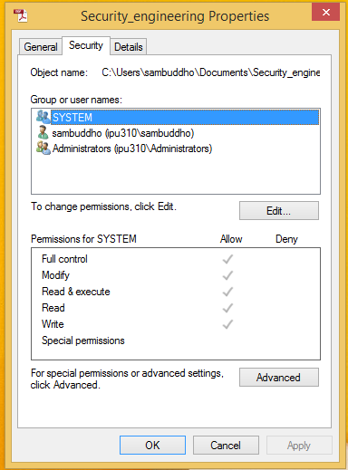
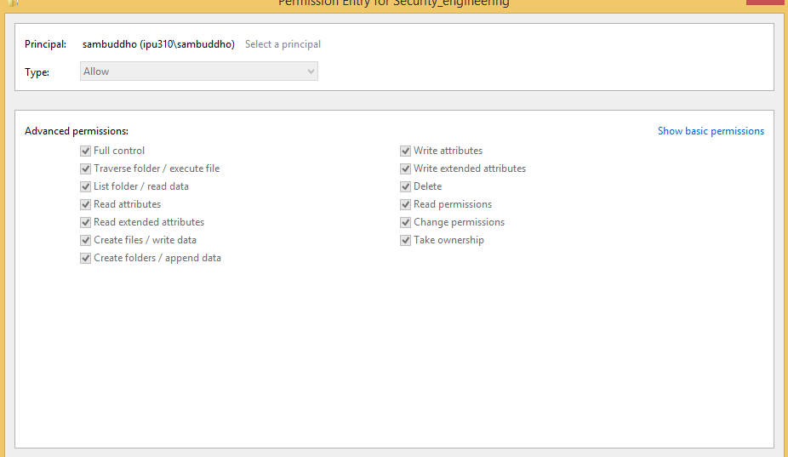
Access Control Features in Windows 7/2008 Server/8

Slide 14
Access Control Lists in Linux
Often not turned on by default.
What you can achieve with standard permissions could also be used with ACLs.
‘setfacl’, ‘getfacl’
Works with the regular permissions but could also potentially break it.
There are multiple users – owner and named users, owning group and named group and others.
Which one is trusted – the owner or the named users ?
‘mask’ bits – different from ‘umask’

Slide 15
Access Control Lists in Linux
Type | Text Form
owner | user::rwx
named user | user:name:rwx
owning group | group::rwx
named group | group:name:rwx
mask | mask::rw-
other | other::rwx
Entry Type | Text Form | Permissions
named user | user:geeko:r-x | r-x
mask | mask::rw- | rw-
 | effective permissions: | r--

Slide 16
Access Control Lists in Linux – Directories and Files
Directories have ‘default’ permissions – ‘default:user’, ‘default:group’ and ‘default:other’. Subdirectories inherit those permissions and default permissions
Files inherit them as regular permissions.
Files are created with mode of 0666. Whatever permissions is not granted in the mode are removed from the ACL permissions granted to the file.
Doesn’t really echo with the default definition.
Possible vulnerabilities when using ACLs ? NFSv2 and v3 FS vulns. Reported in Linux Kernel 2.6.14 and 2.6.15: Failure to correctly validate privileges remotely. CVE-2005-3623

Slide 17
Mandatory Access Controls in Linux: SELinux
Discretionary Access Controls cannot solve all problems –
Owner sets access privileges for files.
Infeasible to set privileges of ALL files in the system.
No mediated access
Recall SUID vulnerabilities
Need a second line of defense if the DAC is compromised.
First line of defense DAC. If allowed by DAC then MAC is checked (enforced).
What all can you do with SELinux –
Enforce MAC/RBAC.
Fine tuned access control, that acts as second line of defense.
Administrator can enforce which system calls a (or a certain class) of users can use.

Slide 18
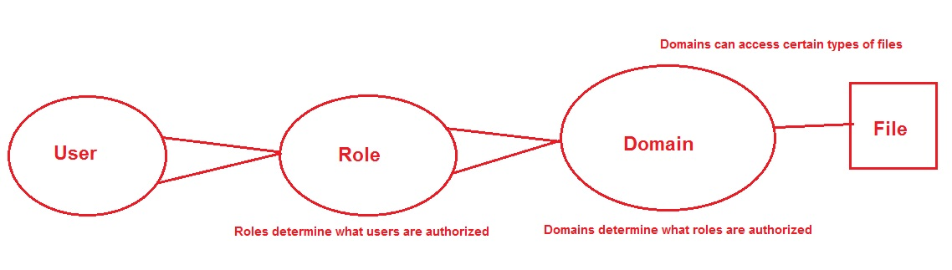
Mandatory Access Controls in Linux: SELinux
The basics (Policy)
Users
Roles – Defines a set of users that can access a process
Subjects and Objects
Domain – A context within which a subject (user or process) operates.
Type – Loose classification of a group of files – associated with its purpose. E.g. files in /etc directory may be classified as one type.
Policy –

Slide 19
Mandatory Access Controls in Linux: SELinux
File Contexts –
ls -Z /etc/*.conf
-rw-r- - r - - root root system_u:object_r:locale_t:s0 /etc/localte.conf
-rw-r- - r - - root root system_u:object_r:etc_t:s0 /etc/man_db.conf
system_u: mapping between user and SELinux user.
object_r: SELinux role.
etc_t: Type
s0: sensitivity

Slide 20
Mandatory Access Controls in Linux: SELinux
Process Contexts –
ps -efZ
system_u:system_r:httpd_t:s0 root 7162 1 0 16:50 ? 00:00:00 /usr/sbin/httpd -D
system_u: mapping between user and SELinux user.
system_r: SELinux role.
httpd_t: Domain (wrapper/bubble within which the process works)
s0: sensitivity
Domain: Used for confining a process. Could be used to prevent the SUID attacks discussed previously.

Slide 21
Mandatory Access Controls in Linux: SELinux
Context inheritance –
Unless otherwise specified the files and processs are created with contexts of their parent files or processes
For files: Copying to “out-of-context” locations results in loosing their original contexts. They acquire the contexts of the destinations.
SELinux users –
Different from regular users – you cannot login with SELinux users.
There are only a small set of these users – e.g.
guest_u: This user doesn't have access to X-Window system (GUI) or networking and can't execute su / sudo command.
user_u: This user has more access than the guest accounts (GUI and networking), but can't switch users by running su or sudo.
staff_u: Same rights as user_u, except it can execute sudo command to have root privileges.
system_u: This user is meant for running system services and not to be mapped to regular user accounts.
Mapping between ordinary users and SELinux users: Role (defined through the above set of users)

Slide 22
Access Controls in Other OSes/MAC/RBAC
FreeBSD: TrustedBSD MAC – derived from Robert Watson’s PhD dissertation -- TCP/UDP port access control lists, inter-user process visibility controls, as well as classic mandatory access control policies such as Multi-Level Security (MLS) with compartments, and fixed- and floating-label Biba integrity policies.
OpenBSD: Lacks MAC, RBAC and other hardening features available in Linux and FreeBSD. Consider very secure, though relies solely on well reviewed code base and error/exception handling.
AndroidOS: Proposals for various MACs
Flaskdroid/SEDroid

Slide 23
References
openSUSE Security Guide. https://doc.opensuse.org/documentation/html/openSUSE_113/opensuse-security/book.security.html. 2012.
Secure Coding in C/C++, Second Edition, Robert C. Seacord, 2015, ISBN-13: 978-0321822130.
Computer Security: Principles and Practices, Second Edition, W. Stallings and L. Browne, 2011, ISBN-13: 978-0312775069.
SELinux Project. National Security Agency (NSA). http://selinuxproject.org/page/Main_Page. 2003.
Access Controls in Windows. MSDNAA. http://msdn.microsoft.com/en-us/library/windows/desktop/aa374860%28v=vs.85%29.aspx

